Slide 1
Taxi demand forecasting
made by team “Upgrade”

Slide 2

Bussines value

Slide 3
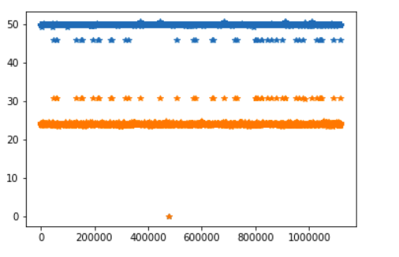
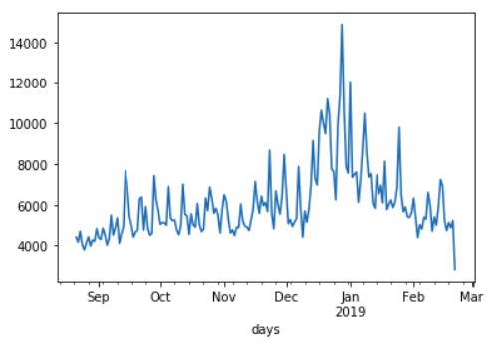
Exploratory data analysis
4328 unique drivers
129181 unique customers
Date from 2018-08-21 to 2019-02-21
Detected and removed outliers in latitude/longitude

Slide 4
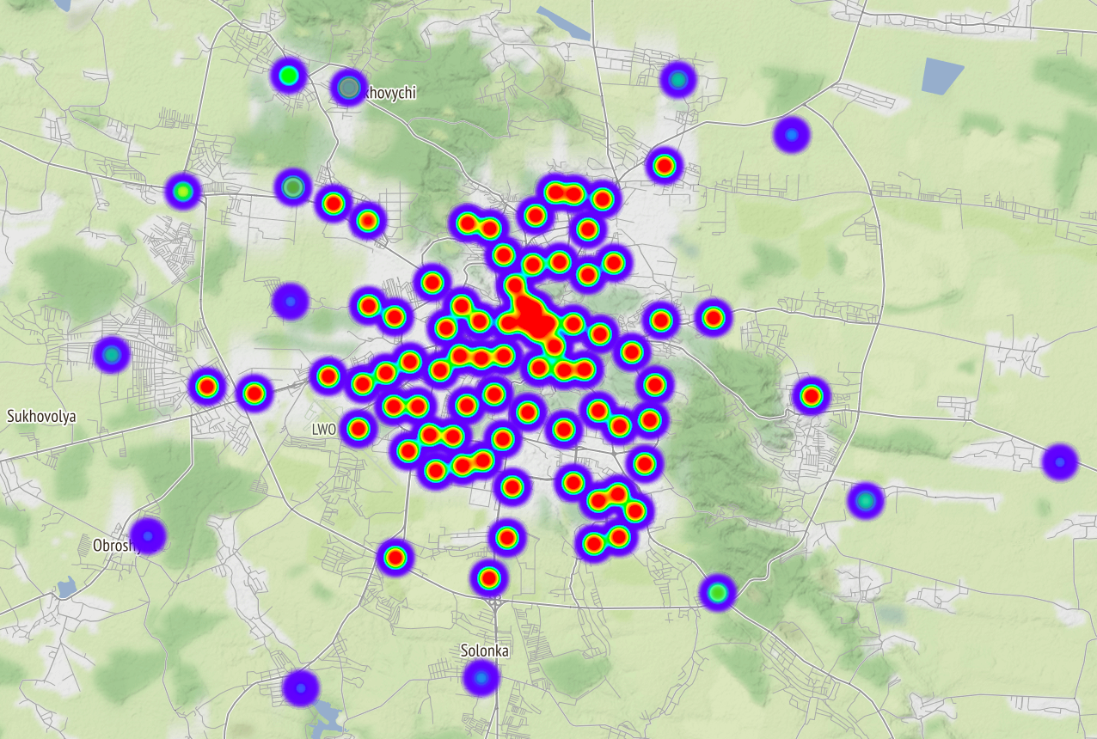
Clustering

Slide 5
Time Series forecasting
Sarima
Exponential smoothing
Holt-Winters Method
LSTM-model

Slide 6
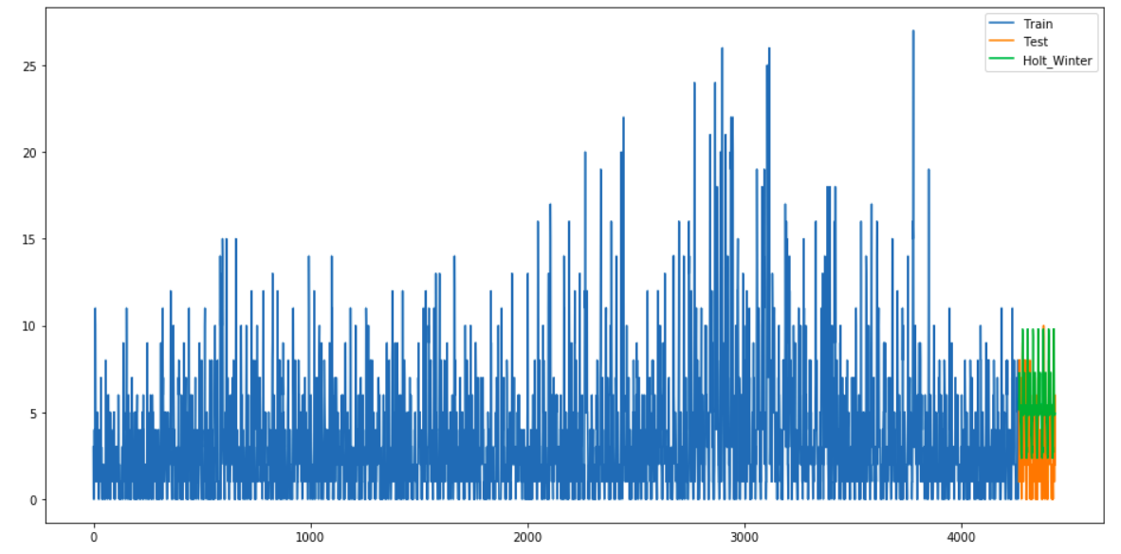
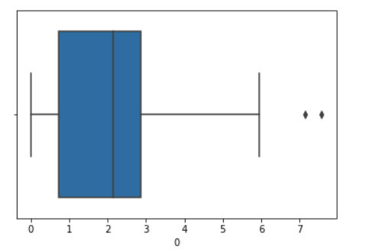
Holt-Winters Method
Holt-Winters Method - 2.1 RMSE (mean for each cluster)

Slide 7
Results
LSTM-model - 1.79 RMSE
(mean for each cluster)

